Slide 1
SIMEM GROUP:
CONCRETE FUTURE SOLUTIONS FOR
BATCHING PLANTS
PRECAST AUTOMATION
UNDERGROUND
Quality oriented and expertise driven integrated solutions

Slide 2
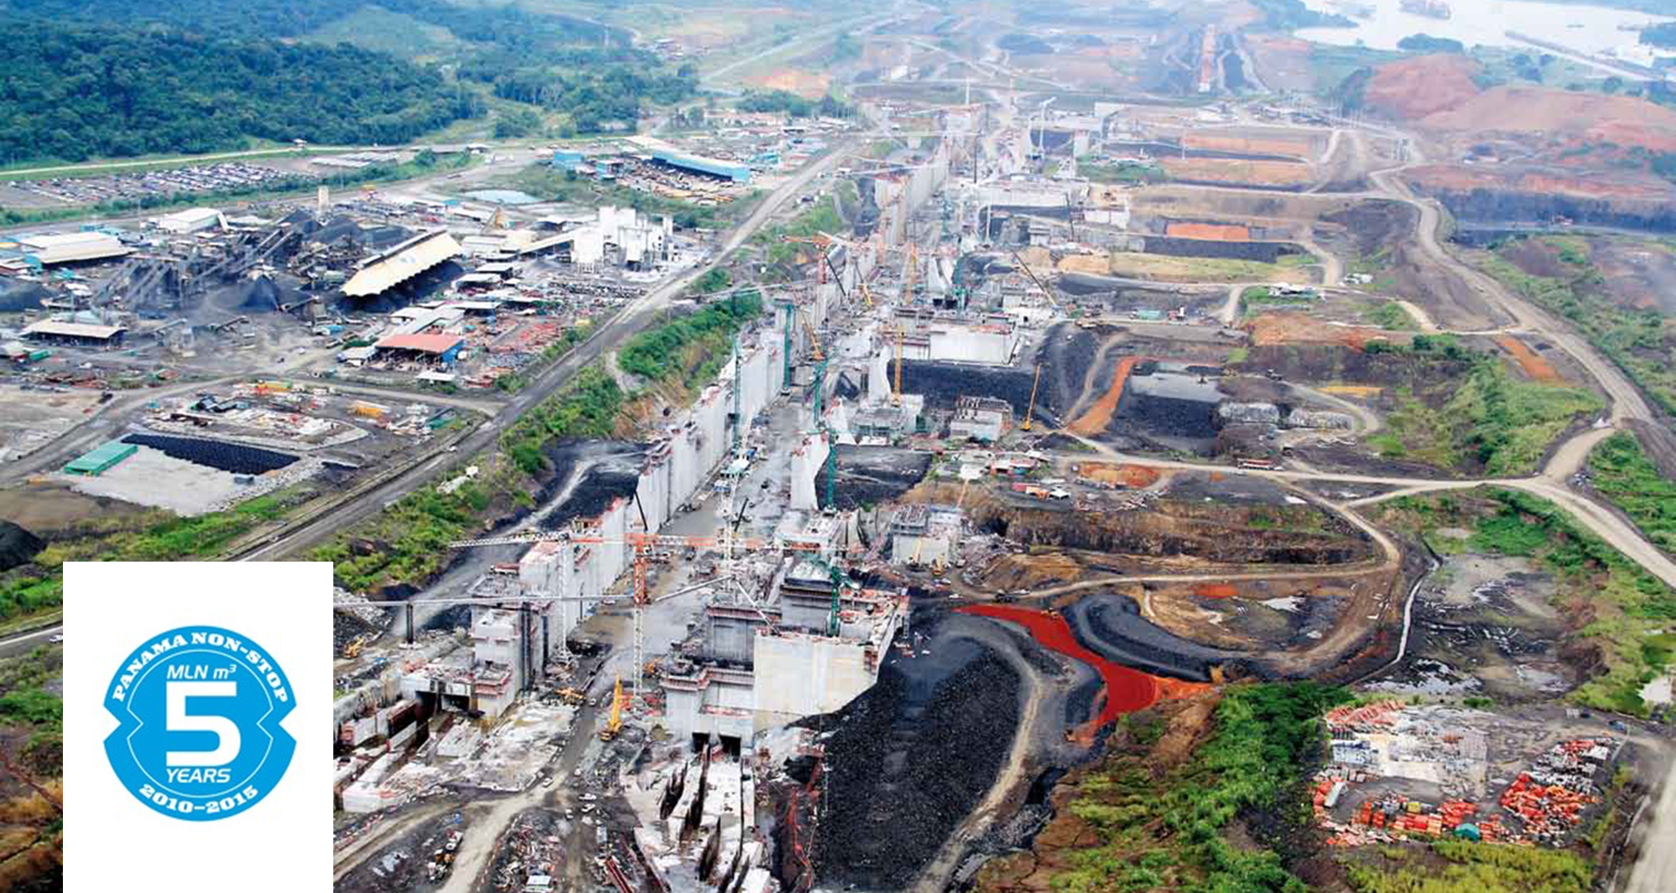
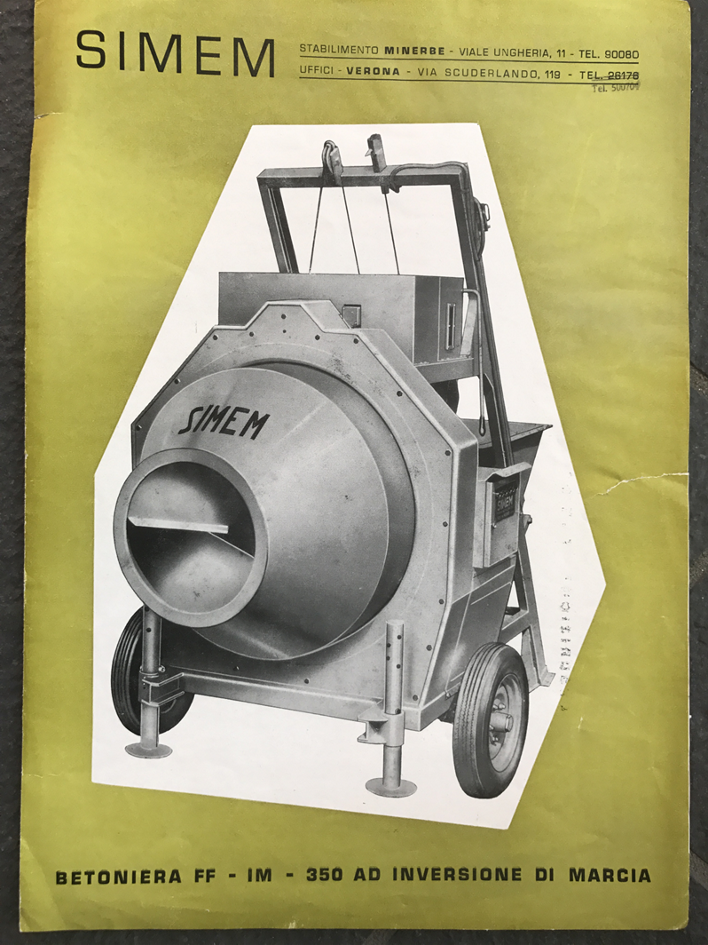
OUR PROMISE – SINCE 1963
HERITAGE, ACCOUNTABILITY, PARTNERSHIP
Notes:
Integrare unica organizzazione tutte le attività: ingegneria, produzione, logistica, installazione, service

Slide 3
SIMEM WORLDWIDE
Fare clic per inserire testo
SIMEM S.P.A. – Global Headquarters, Minerbe (VR) – Italy
Simem Spil – Automated Precast Production Solutions, Treviso – Italy
SIMEM Underground Solutions – Tunneling/Mining, Abbotsford, BC – Canada
SIMEM America – Concrete Technologies, Texas – USA
SIMEM Deutschland - Germany
SIMEM India – Vadodara-Gujarat - India
SIMEM Russia– Concrete Technologies, Yaroslavl – Russian Federation
SIMEM Family Company
Dealer Representation
Direct Client Activity
Concrete Future Solutions

Slide 4
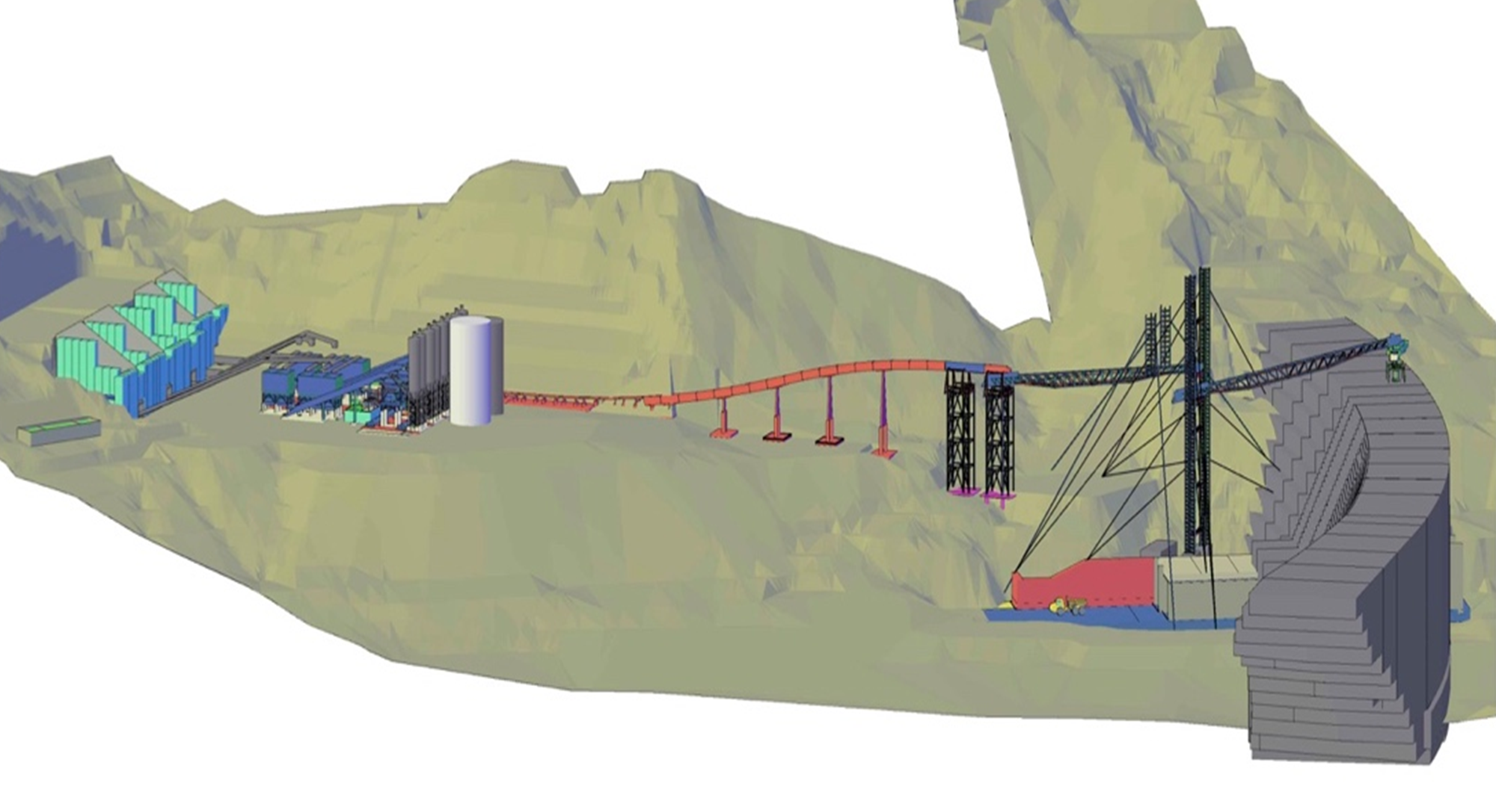
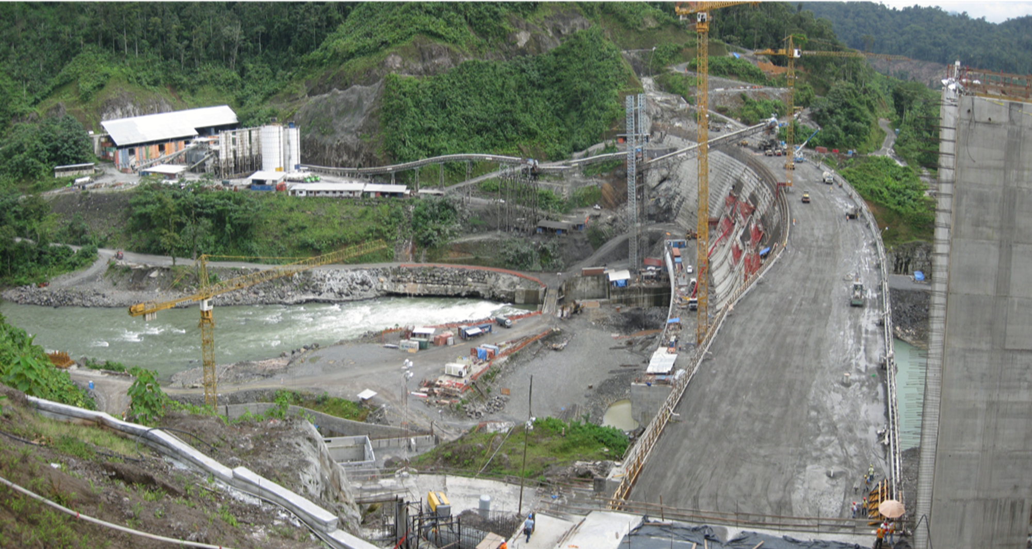

Slide 5
Video Digital Concrete

Slide 6

WHEREVER IN THE WORLD, SIMEM PERFORMS

