Slide 1



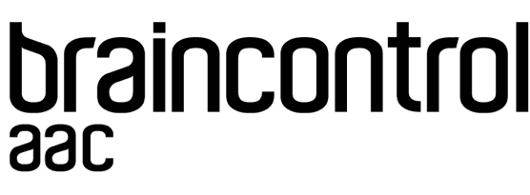
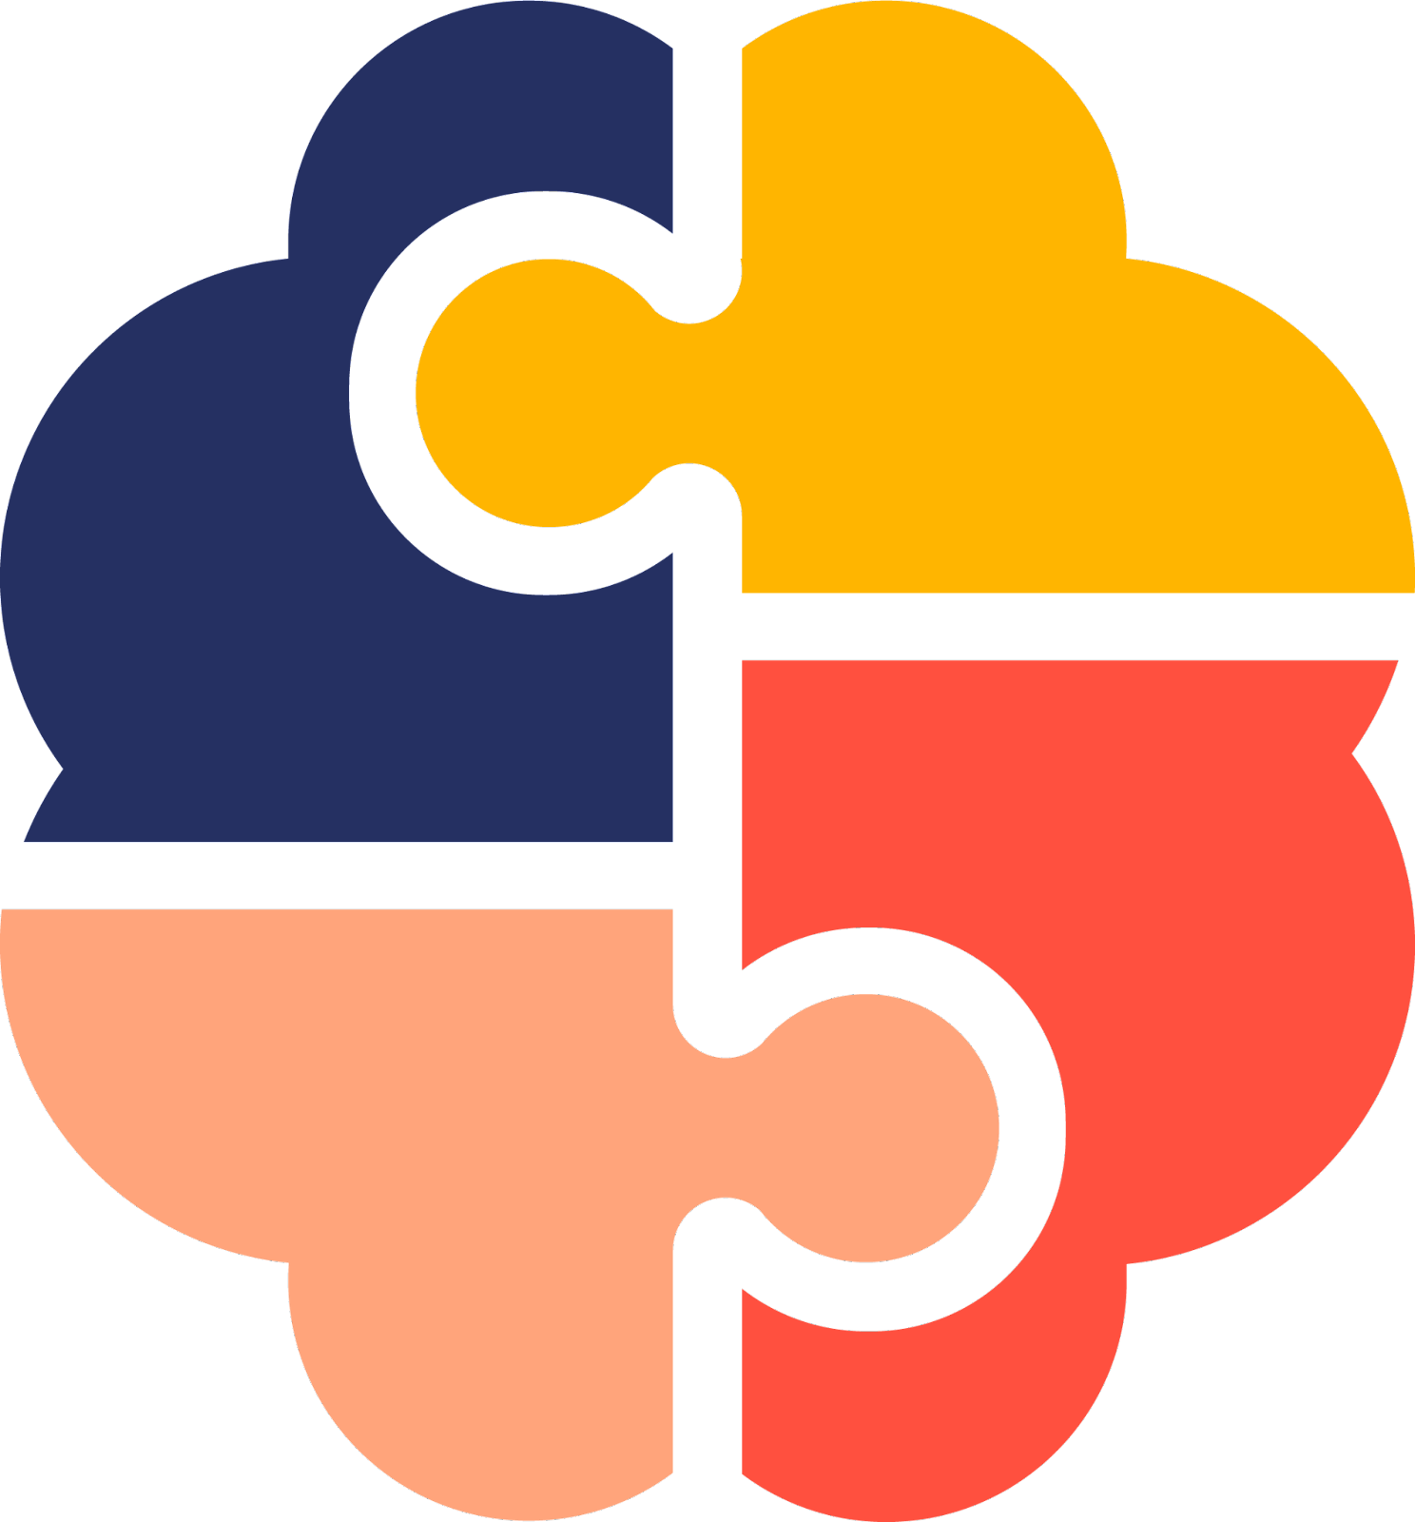
Tre prodotti, basati su IA,
in ambito Digital Health
Mindahead
Pasquale Fedele
@pascalif
Intelligenza artificiale e PMI: esperienze da un futuro presente
Firenze 18 aprile 2023
Copyright ▪ 2023
Notes:
Thank you so much for your time & interest - We are very much looking forward to partnering up with you.

Slide 2
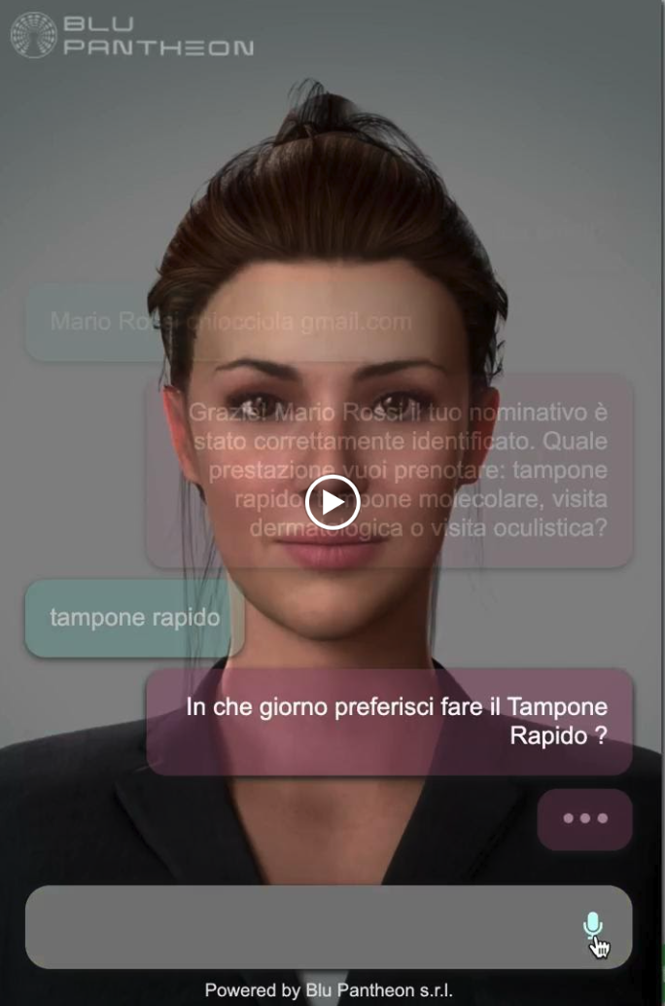


CUP & AI
Assistente virtuale

Slide 3
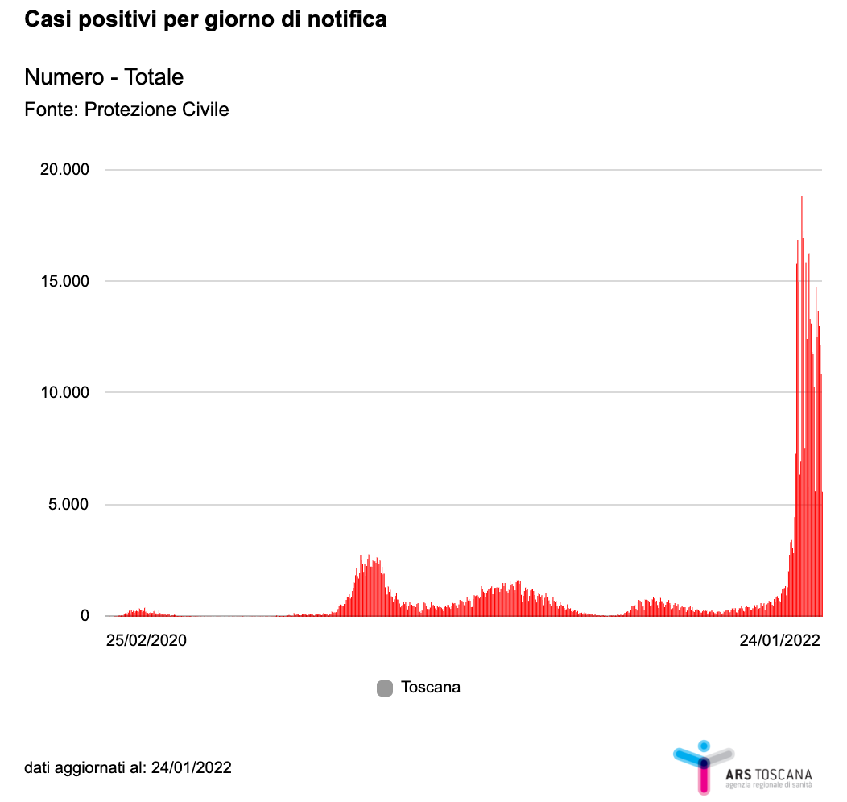
10.000 positivi
50.000 contatti stretti
60.000 chiamate/giorno
2.400 positivi
12.000 contatti stretti
14.400 chiamate/giorno

Slide 4


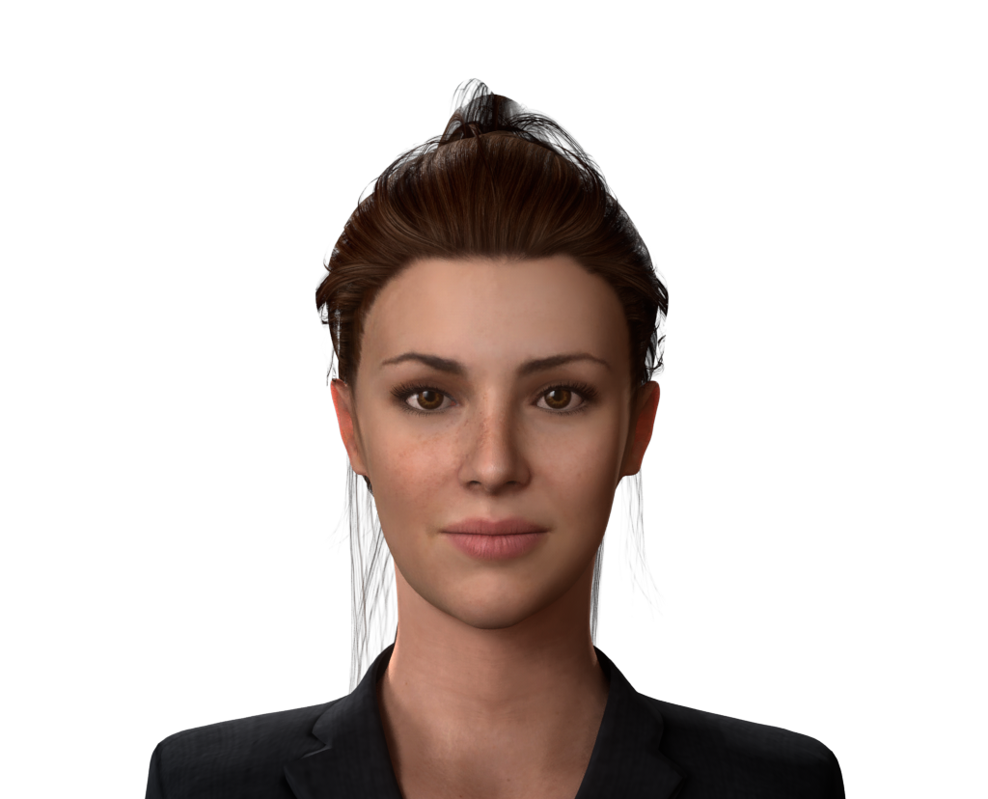



COVID-19 | Contact-Tracing
CONVERSATIONAL AI
STT
KB
PHONE HUB
VIRTUAL AGENT
VISUAL
AVATAR
TTS
WEB SERVER
SERVICES

Slide 5

COVID-19 | Contact-Tracing

Slide 6







Mind power for assistive technologies
Microsoft Health Innovation Awards

Slide 7
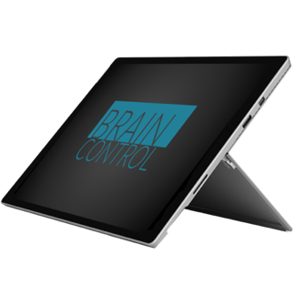

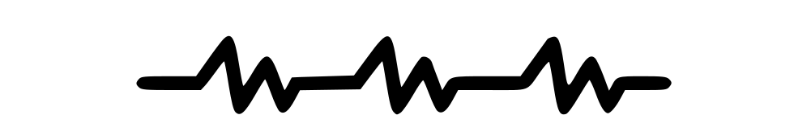


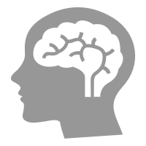



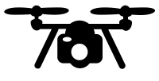
BRAINCONTROL WORKS
LIKE A MENTAL JOYSTICK
INPUT
PATTERNS
RECOGNITION
CONTROL
OUR PROPRIETARY SOFTWARE
MACHINE LEARNING
ARTIFICIAL INTELLIGENCE
BRAIN-COMPUTER INTERFACE
COMMUNICATOR
DOMOTIC CONTROL
WHEELCHAIR
ROBOTICS

Slide 8
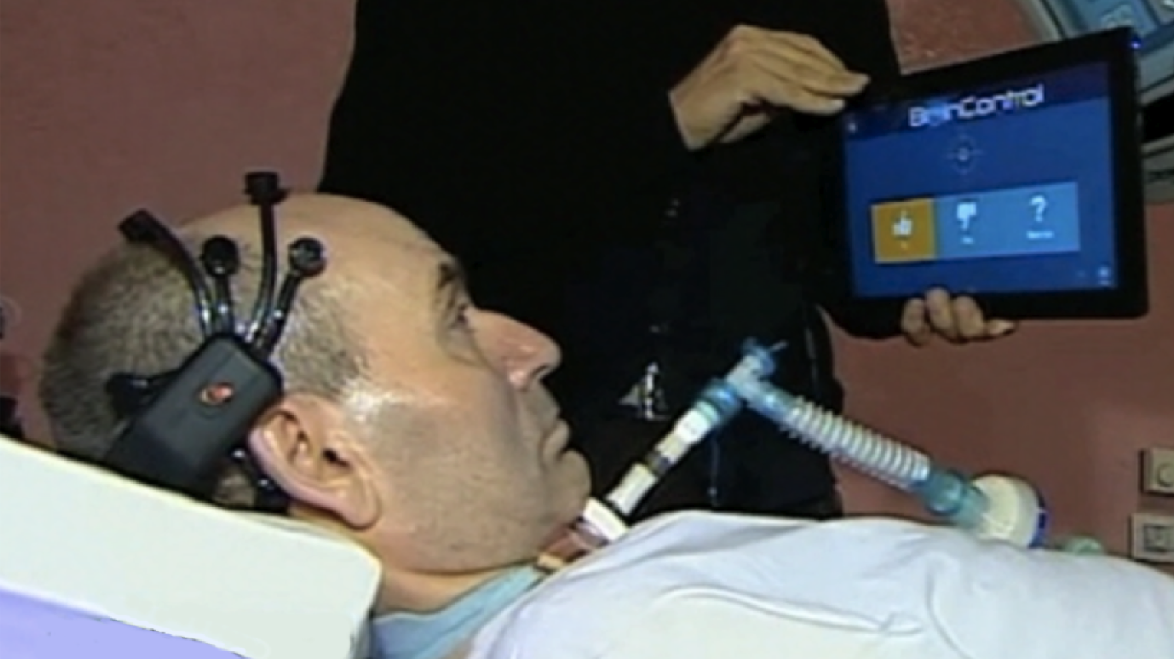
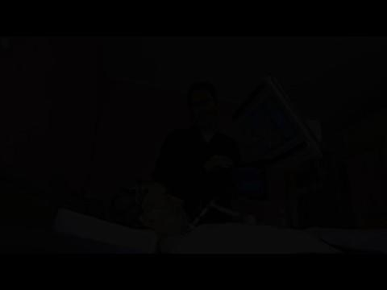
THANKS TO BRAINCOTROL MANY PATIENTS
IN LIS/CLIS ARE TODAY ABLE TO
INTERACT AND COMMUNICATE
VIDEO: https://bit.ly/2J1aOMf

Slide 9
Mind power for assistive technologies
Microsoft Health Innovation Awards

Slide 10



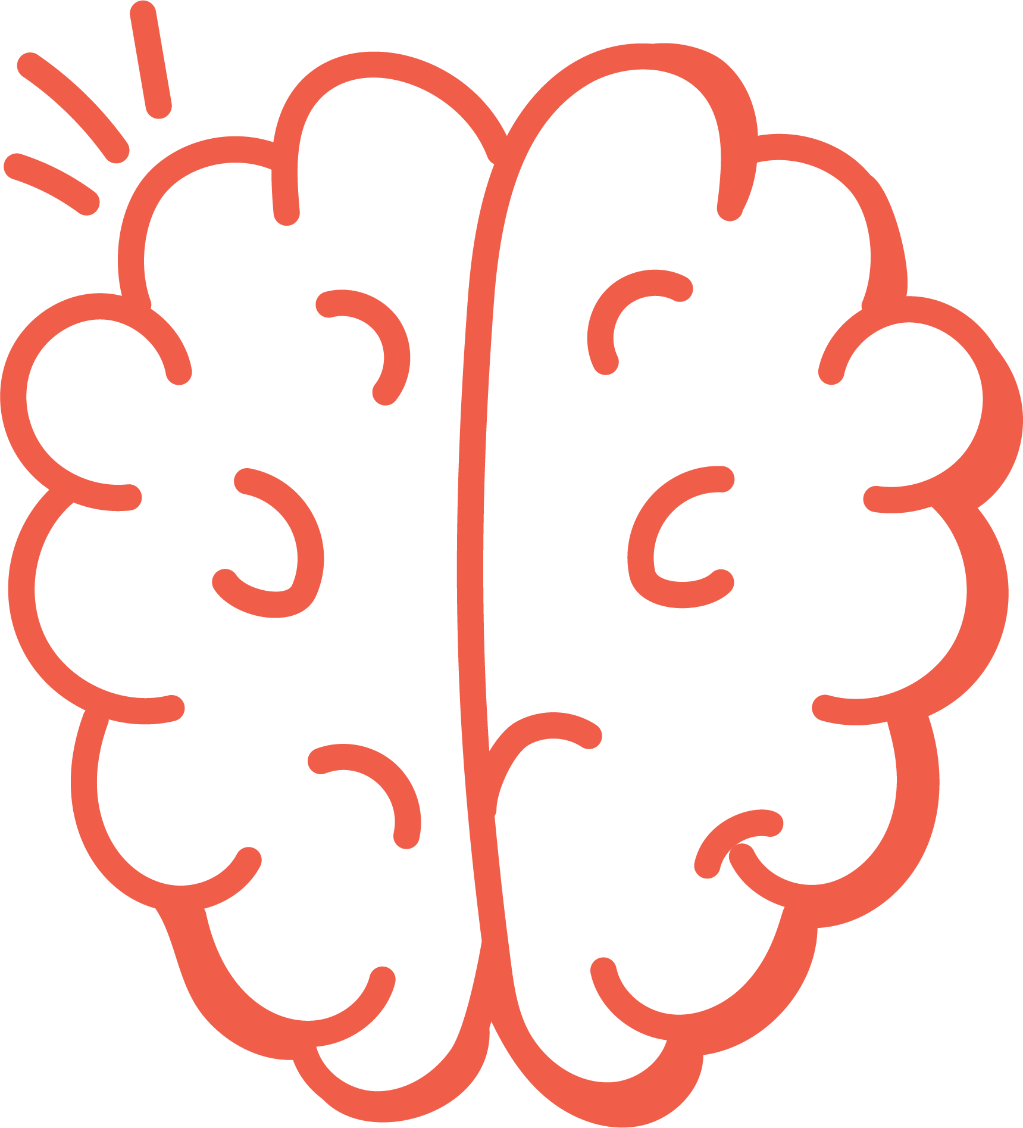
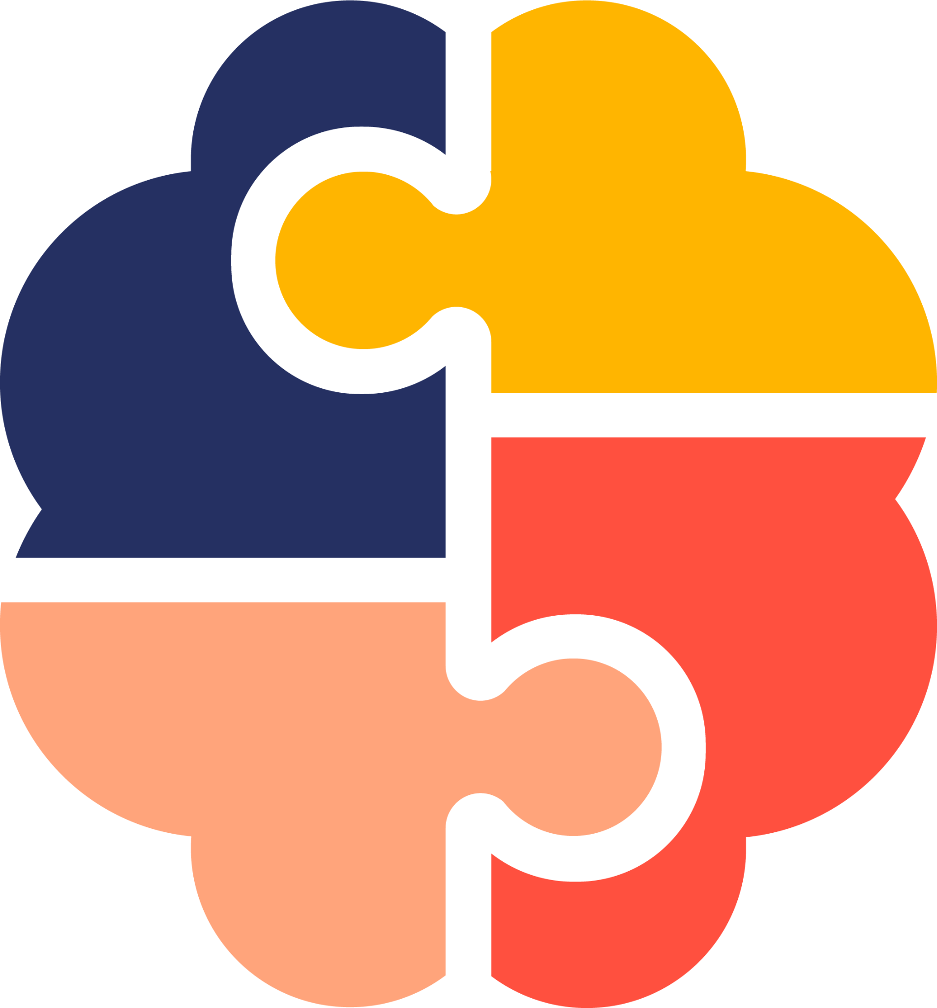


Mind
Early detection and prevention of dementia
Ahead
Notes:
Every 3 seconds, someone in the world develops dementia.
Getting dementia is terrifying - to realize that you can no longer trust your own mind is frightening, both for you and for your loved ones - as they see you drifting away more and more.
While there are no drugs to cure dementia, effective management relies on prevention and early detection.
***
MindAhead is about being and staying cognitively fit - and it's a topic that really affects us all. Maybe think about your parents or grandparents - they might be in an age where first things such as forgetting where the car was parked or where the glasses were put might become visible- and that could be normal signs of ageing, but it also could not.
We want to help to find this out and give them the chance to live an autonomous life as long as possible.
****
Take-Home Message:
Excitement for the Pitch

Slide 11

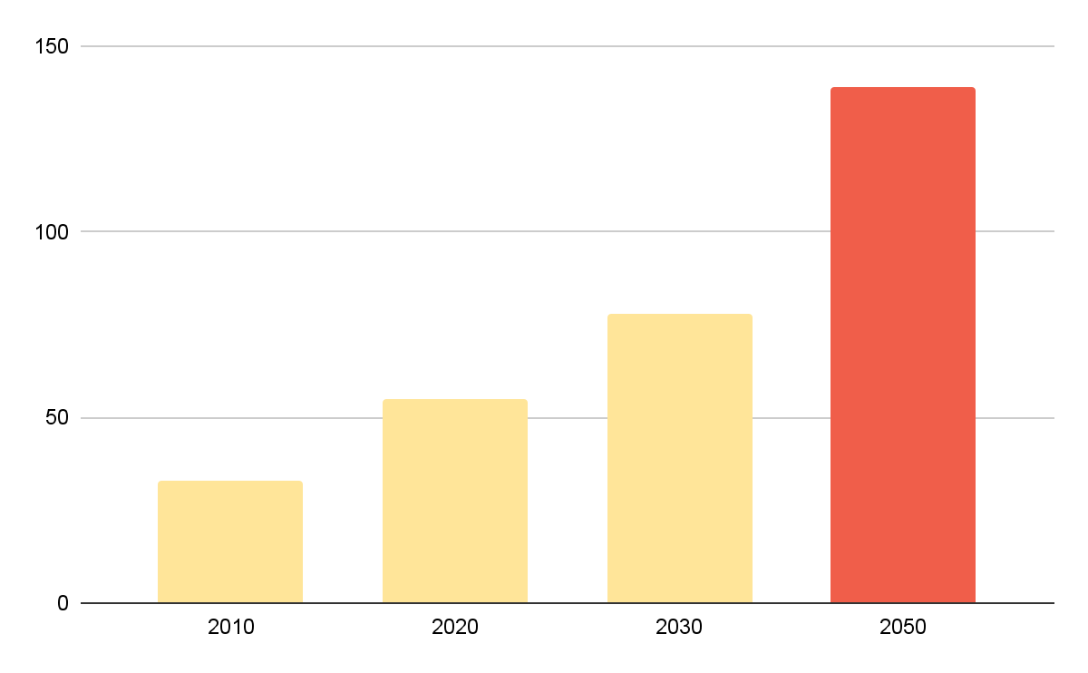
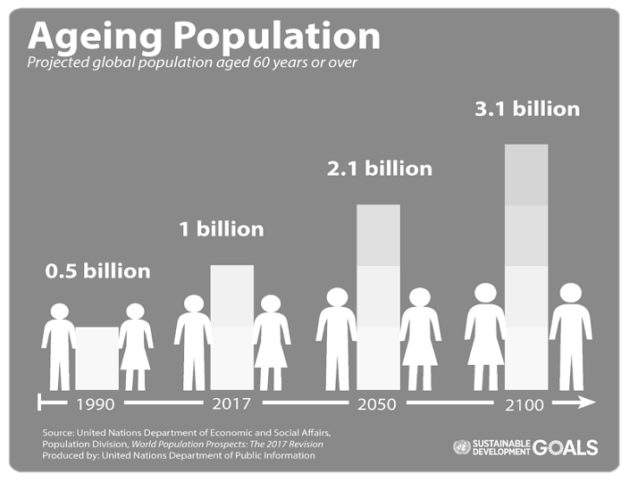
By 2030, 1 in 6 people in the world will be aged 60 years or over. The cases of dementia will more than double by 2050.
Dementia Cases Worldwide (in million)
139
78
55
33
﻿https://www.who.int/news-room/fact-sheets/detail/dementia
Notes:
In fact, by 2030, 1 out of 6 people in the world will be aged 60 years and older, while the cases of dementia will nearly double by 2050, up to 139 mio worldwide.
In Germany we currently have 1.6 mio dementia cases diagnosed, which is also supposed to double to 3.2 Mio in the next years.
(Etwa ein Drittel der Menschen, die aufgrund der Alzheimer-Krankheit mit MCI leben, entwickeln innerhalb von fünf Jahren eine Demenz.)

Slide 12

Since there are no curative drugs, we can only prevent dementia by identifying at-risk patients early and intervening in time.
The Continuum of Alzheimer Disease (AD)
Cognitive function
Normal Aging
Preclinical
Up to 40% of all dementia cases could be prevented or considerably delayed.*
Mild Cognitive
Impairment - MCI
Dementia
Time
Adapted version from Seth A. Gale, Diler Acar, Kirk R. Daffner, Dementia, The American Journal of Medicine, Volume 131, Issue 10, 2018
*https://www.thelancet.com/article/S0140-6736(20)30367-6/fulltext
Notes:
The underlying problem is that as we age, cognitive decline increases.
Currently, there is no way to identify dementia risk patients at a really early stage. And that is enormously important: because once dementia has been diagnosed, there is no medication to cure it.
However, there are preliminary stages of dementia - this is called MCI (Mild Cognitive Impairment) > at which stage you can still achieve and build your brain health - In fact, up to 40% of all cases could be prevented or delayed when starting early enough. Currently, however, in Germany, only 4.5% of all MCI patients are diagnosed.
In order to tackle the growing cognitive impairments in our world, we need to 1) identify the patients early and 2) then intervene.

Slide 13


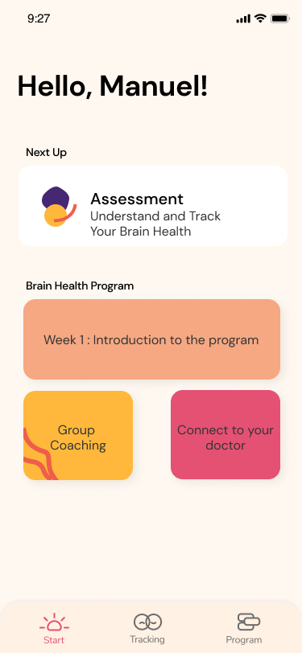


That is why we built a digital application for early detection of cognitive impairment and a behavioral activation-based brain health program.
Early Detection
of MCI through playful, fast, cognitive tracking.
Brain Health Program
to reduce dementia risk through risk factor modification and lifestyle coaching.
Notes:
And this is where MindAhead comes in: We are creating a digital application for early detection of exactly these MCI patients, through game-based tracking, together with a brain health program to build up brain health.
We aim for early intervention in the form of risk factor modifications and lifestyle interventions, so that the risk of dementia can be positively influenced and the cognitive reserve can be build up.

Slide 14
Tre prodotti, basati su IA,
in ambito Digital Health
Mindahead
Pasquale Fedele
@pascalif
Intelligenza artificiale e PMI: esperienze da un futuro presente
Firenze 18 aprile 2023
Copyright ▪ 2023
Notes:
Thank you so much for your time & interest - We are very much looking forward to partnering up with you.

